Slide 1
GEOG0125
Advanced Topics in Social and Geographic Data Science
spatial temporal MODELs & Bayesian updating
Dr Anwar Musah (a.musah@ucl.ac.uk)
Lecturer in Social and Geographic Data Science
UCL Geography
1

Slide 2
Contents
Problem
A quick recap of Week 8’s ICAR model
Data scenarios
Bayesian Updating for repeated cross-sectional datasets
Spatial Temporal Models for longitudinal datasets
What is Bayesian Updating:
Let’s explore an example: Mosquito infestation in Campina Grande, Brazil
Model framework in Stan
What are Spatial Temporal Models
Let’s explore an example: Fire-related casualties (2010—2019)
Model framework in a different R package called INLA
Knowledge
Collect
Model
Wrangle
Explore
2

Slide 3
Quick recap on last week’s ICARs for spatial risk modelling
3

Slide 4
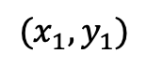
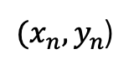
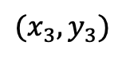
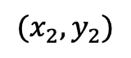
We situated hierarchical models within a spatial context:
Bayesian inference, are often used in hierarchical modelling, which are models commonly used in the quantification of spatial and spatiotemporal areal data.
Bayesian approach are incredibly good with datasets that have a hierarchical structure.
These are statistical model written in multiple levels (i.e., hierarchical form) to estimate parameters of the posterior distribution
Example: Intestinal parasitaemia among school children in Tanzania and infection status linked with anaemia
Health student =
Diseased student =
…
School 1
School 2
School 3
School n
Point locations:
$${(x}_{1},y_{1})$$
$${(x}_{2},y_{2})$$
$$(x_{3},y_{3})$$
$(x_{n},y_{n}$)
4
Notes:
Bayesian inference with a

Slide 5
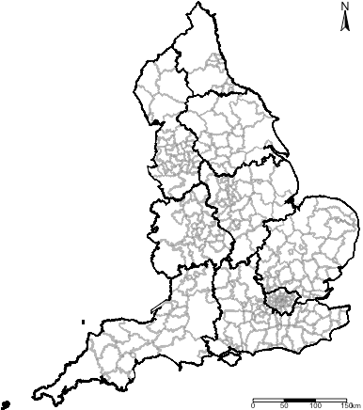
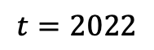
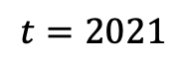
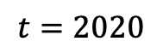
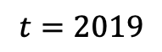
Level 2:
$$t=2019$$
$$t=2020$$
$$t=2021$$
$$t=2022$$
Level 1:
These models allow complete flexibility in the estimation of risks - allowing the user to account for space-time interactions
You can make the model (in contrast to frequentist) to borrow strength across space-time, in order to improve estimation and prediction of an underlying model’s feature
5

Slide 6
Besag-York-Mollie (BYM) (or ICAR models)
This is a popular spatial model which takes into account that the data may potentially be spatially correlated and the observations in the neighbouring areas may be more similar than observations in areas that are distant from each other.
This is a type of hierarchical model which includes a spatial random effect,
It is heavily dependent on the neighbourhood adjacency matrix
ICAR stands for Intrinsic spatial Conditional Auto-Regressive Models
There are two versions of this model:
BYM model that has a spatial effect term only that’s treated a smoothing term (multiplied by an error term)
BYM model that has both a spatial effect term which is treated a structured random effect, and the error term is an unstructured noise
When fitting data to this type of model – the best choice of the likelihood function (i.e., statistical model) is
Poisson (i.e., aggregated counts (for rates) to areas);
Or otherwise, it’s Binomial (aggregate counts (for proportions) to areas).
6
Notes:
Bayesian inference with a

Slide 7
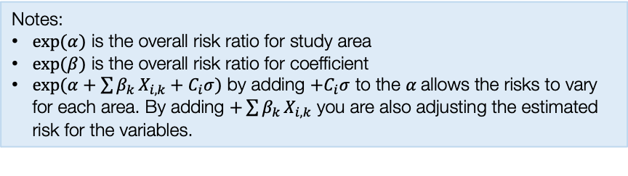
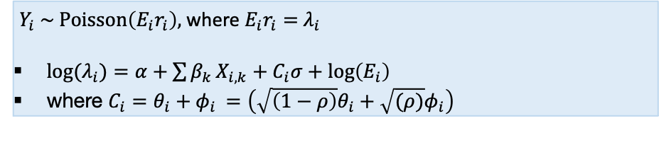
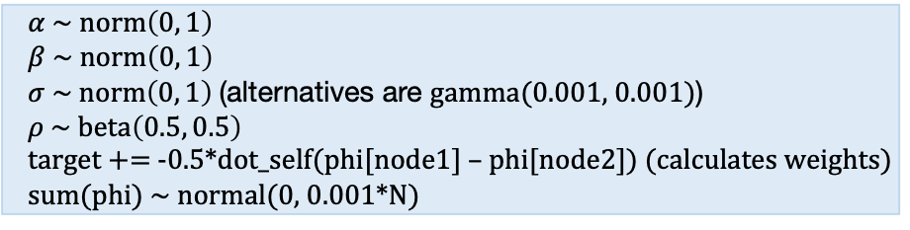
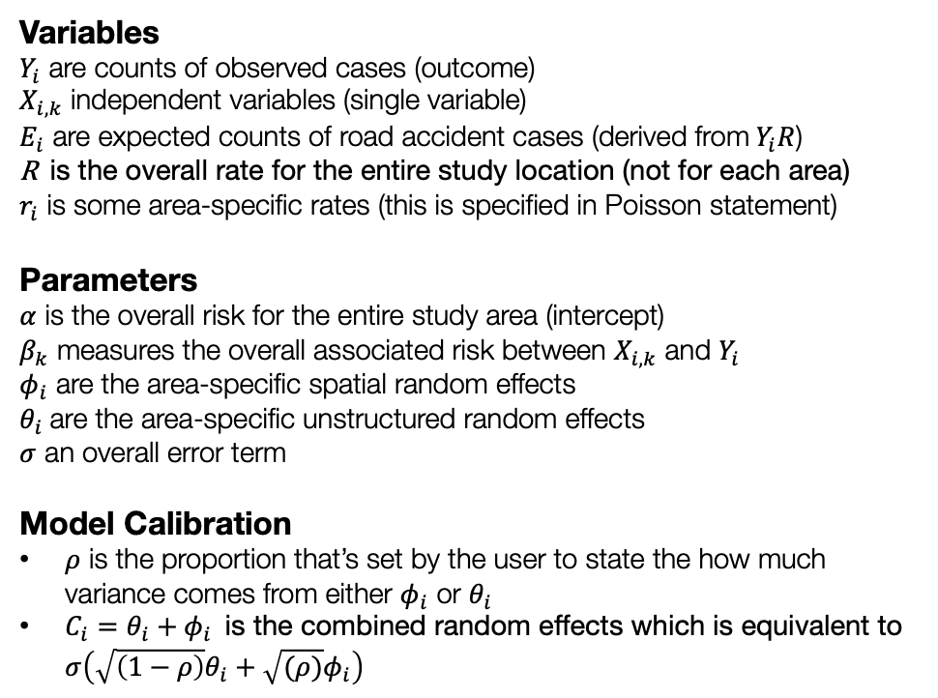
General model formulation for Spatial ICAR model
Model components
Full model specification
Variables
$Y_{i}$ are counts of observed cases (outcome)
$X_{i,k}$ independent variables (single variable)
$E_{i}$ are expected counts of road accident cases (derived from$Y_{i}R$)
R is the overall rate for the entire study location (not for each area)
$r_{i}$ is some area-specific rates (this is specified in Poisson statement)
Parameters
$α$ is the overall risk for the entire study area (intercept)
$β_{k}$ measures the overall associated risk between $X_{i,k}$ and $Y_{i}$
$φ_{i}$ are the area-specific spatial random effects
$θ_{i}$ are the area-specific unstructured random effects
$σ$ an overall error term
Model Calibration
$ρ$ is the proportion that’s set by the user to state the how much variance comes from either $φ_{i}$ or $θ_{i}$
$C_{i}=θ_{i}+φ_{i}$ is the combined random effects which is equivalent to $σ\left(\sqrt{\left(1−ρ\right)}θ_{i}+\sqrt{(ρ)}φ_{i}\right)$
Specify likelihood function. The outcome is often counts – thus it will be Poisson (with log as the link function).
$Y_{i} \sim Poisson\left(E_{i}r_{i}\right),$where $E_{i}r_{i}=$ $λ_{i}$
${log⁡(λ}_{i})=α+\sum{β_{k}}X_{i,k}+C_{i}σ+log\left(E_{i}\right)$
where $C_{i}=θ_{i}+φ_{i}$ $=\left(\sqrt{\left(1−ρ\right)}θ_{i}+\sqrt{(ρ)}φ_{i}\right)$
Define the priors for the intercept, coefficients and spatial and unstructured random effects as with an ICAR specification
$α \sim norm\left(0, 1\right)$
$β \sim norm\left(0, 1\right)$
$σ \sim norm\left(0, 1\right)$ (alternatives are gamma(0.001, 0.001))
$ρ \sim beta\left(0.5, 0.5\right)$
target += -0.5*dot_self(phi[node1] – phi[node2]) (calculates weights)
sum(phi) ~ normal(0, 0.001*N)
Build Bayesian model
Recall the Bayes’ Rule: $P\left(θ | Y\right)∝P\left(Y | θ\right)P(θ)$
Notes:
$exp⁡(α)$ is the overall risk ratio for study area
$exp⁡(β)$ is the overall risk ratio for coefficient
$exp(α+\sum{β_{k}}X_{i,k}+C_{i}σ)$ by adding ${+C}_{i}σ$ to the $α$allows the risks to vary for each area. By adding $+\sum{β_{k}}X_{i,k}$ you are also adjusting the estimated risk for the variables.
$$P\left(α, β_{k}, σ, φ_{i} | { λ}_{i}\right)∝P\left({ λ}_{i} | α, β_{k}, σ, φ_{i}\right) P\left(α\right)P\left(β_{k}\right)P\left(σ\right)P(φ_{i})P\left(ρ\right)$$
7

Slide 8
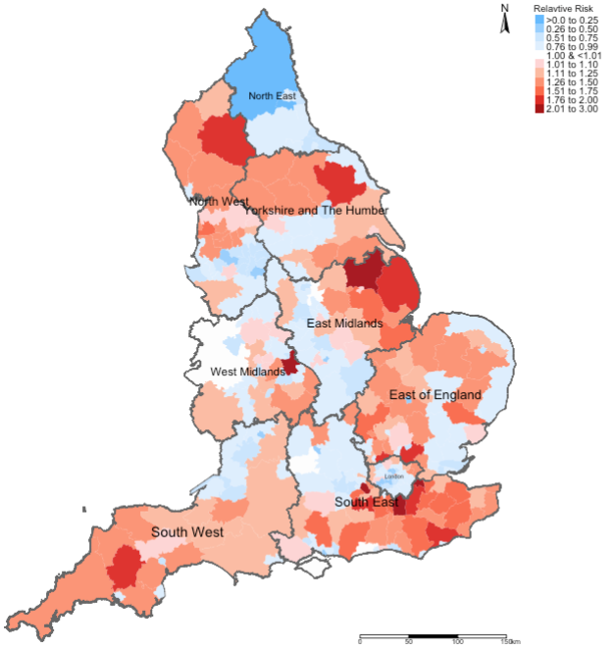
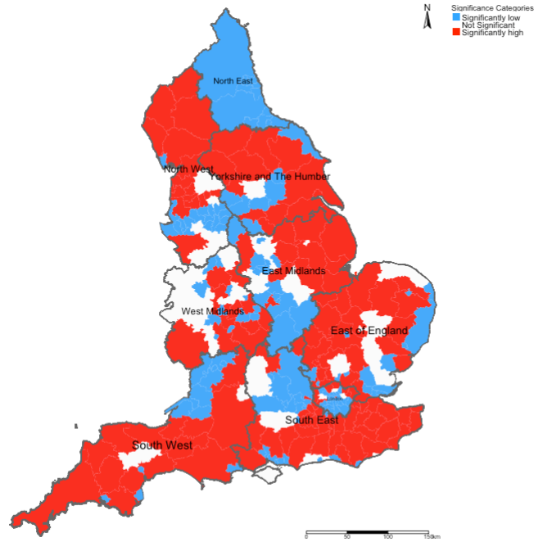
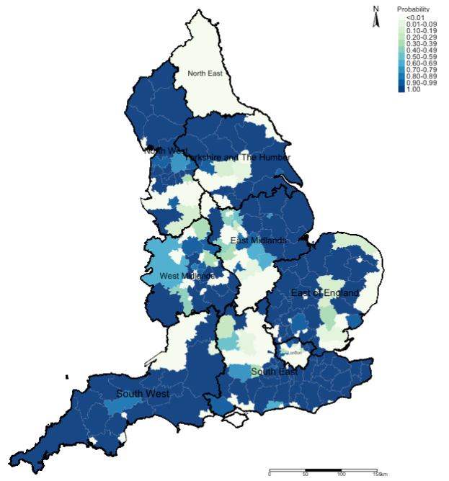
[1] Relative risk ratios (RR)
[2] Statistical Significance
[3] Exceedance Probabilities
Here, we use this output to describe the burden of an outcome
This output is to validate whether the risks described in output [1] are statistically significant or not
This output is used to describe the uncertainty that surrounds the risks which we found output [1]
8

Slide 9
Application a cross-sectional framework
 | Survey Periods
LIRAa | 2013 | 2014 | 2015 | 2016 | 2017
1 | January | January | January | April | January
2 | March | March | March | July | April
3 | May | May | May | October | July
4 | July | July | October
5 | October | October
Using this snapshot time-period for April to demonstrate the application. This is a Cross-sectional framework
Methodology:
Population-based ecological study design within cross-sectional (and retrospective) framework
For covariates, the analysis included:
WorldClim (4.5km) (Maximum temperature and Precipitation) (monthly)
MOD18A1.061 Terra Vegetation Indices 16-Day Global 500m to compute neighbourhood levels of vegetation based on the NDVI metrics (monthly)
Worldpop.org (100m) to extract rasters for urbanisation (which contains binary grids) to compute the fraction of surface that is urbanised for neighbourhoods (yearly).
Spatial risk model with Intrinsic Conditional Autoregressive (ICAR) Model; and to derive new global coefficients for covariates for at that survey period for April 2017, as well as neighbourhood-specific relative risk estimates.
9
Notes:
In terms of methodology, we utilised

Slide 10
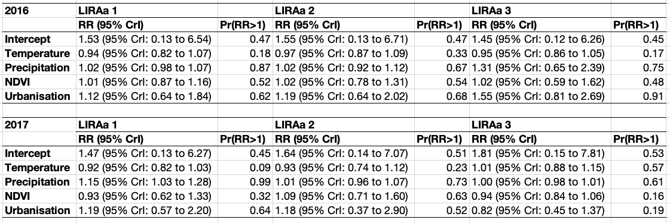
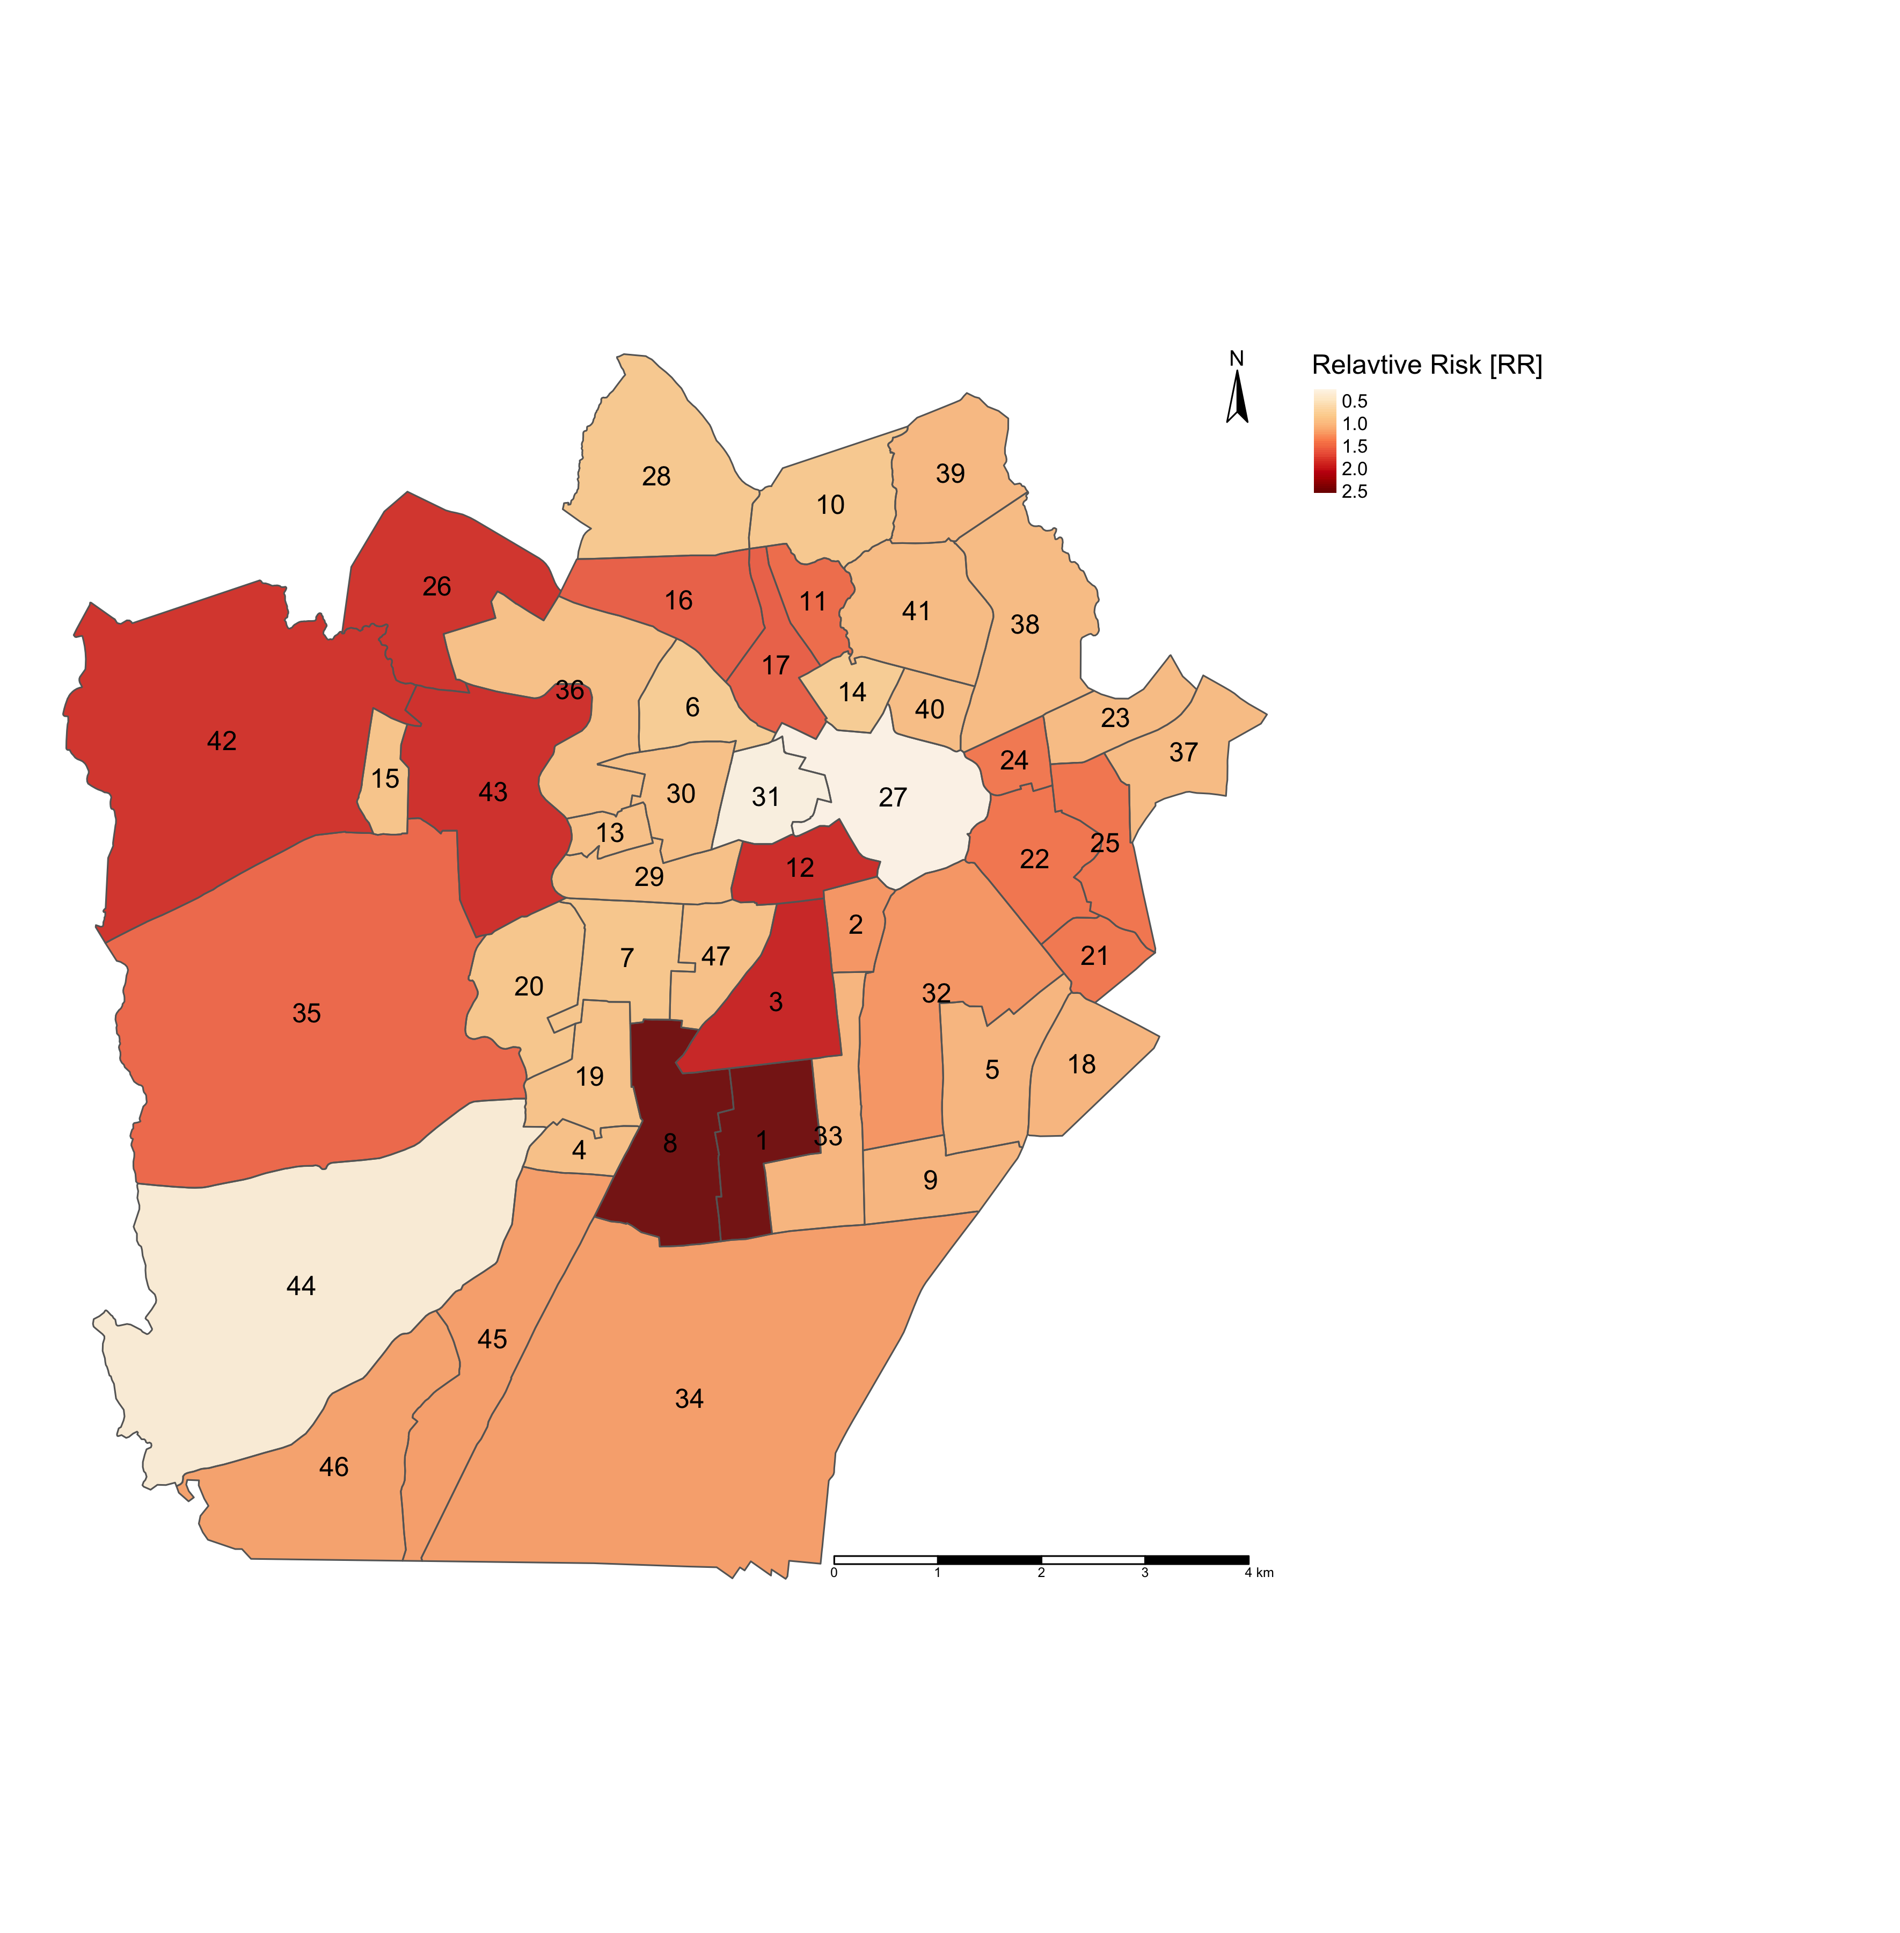
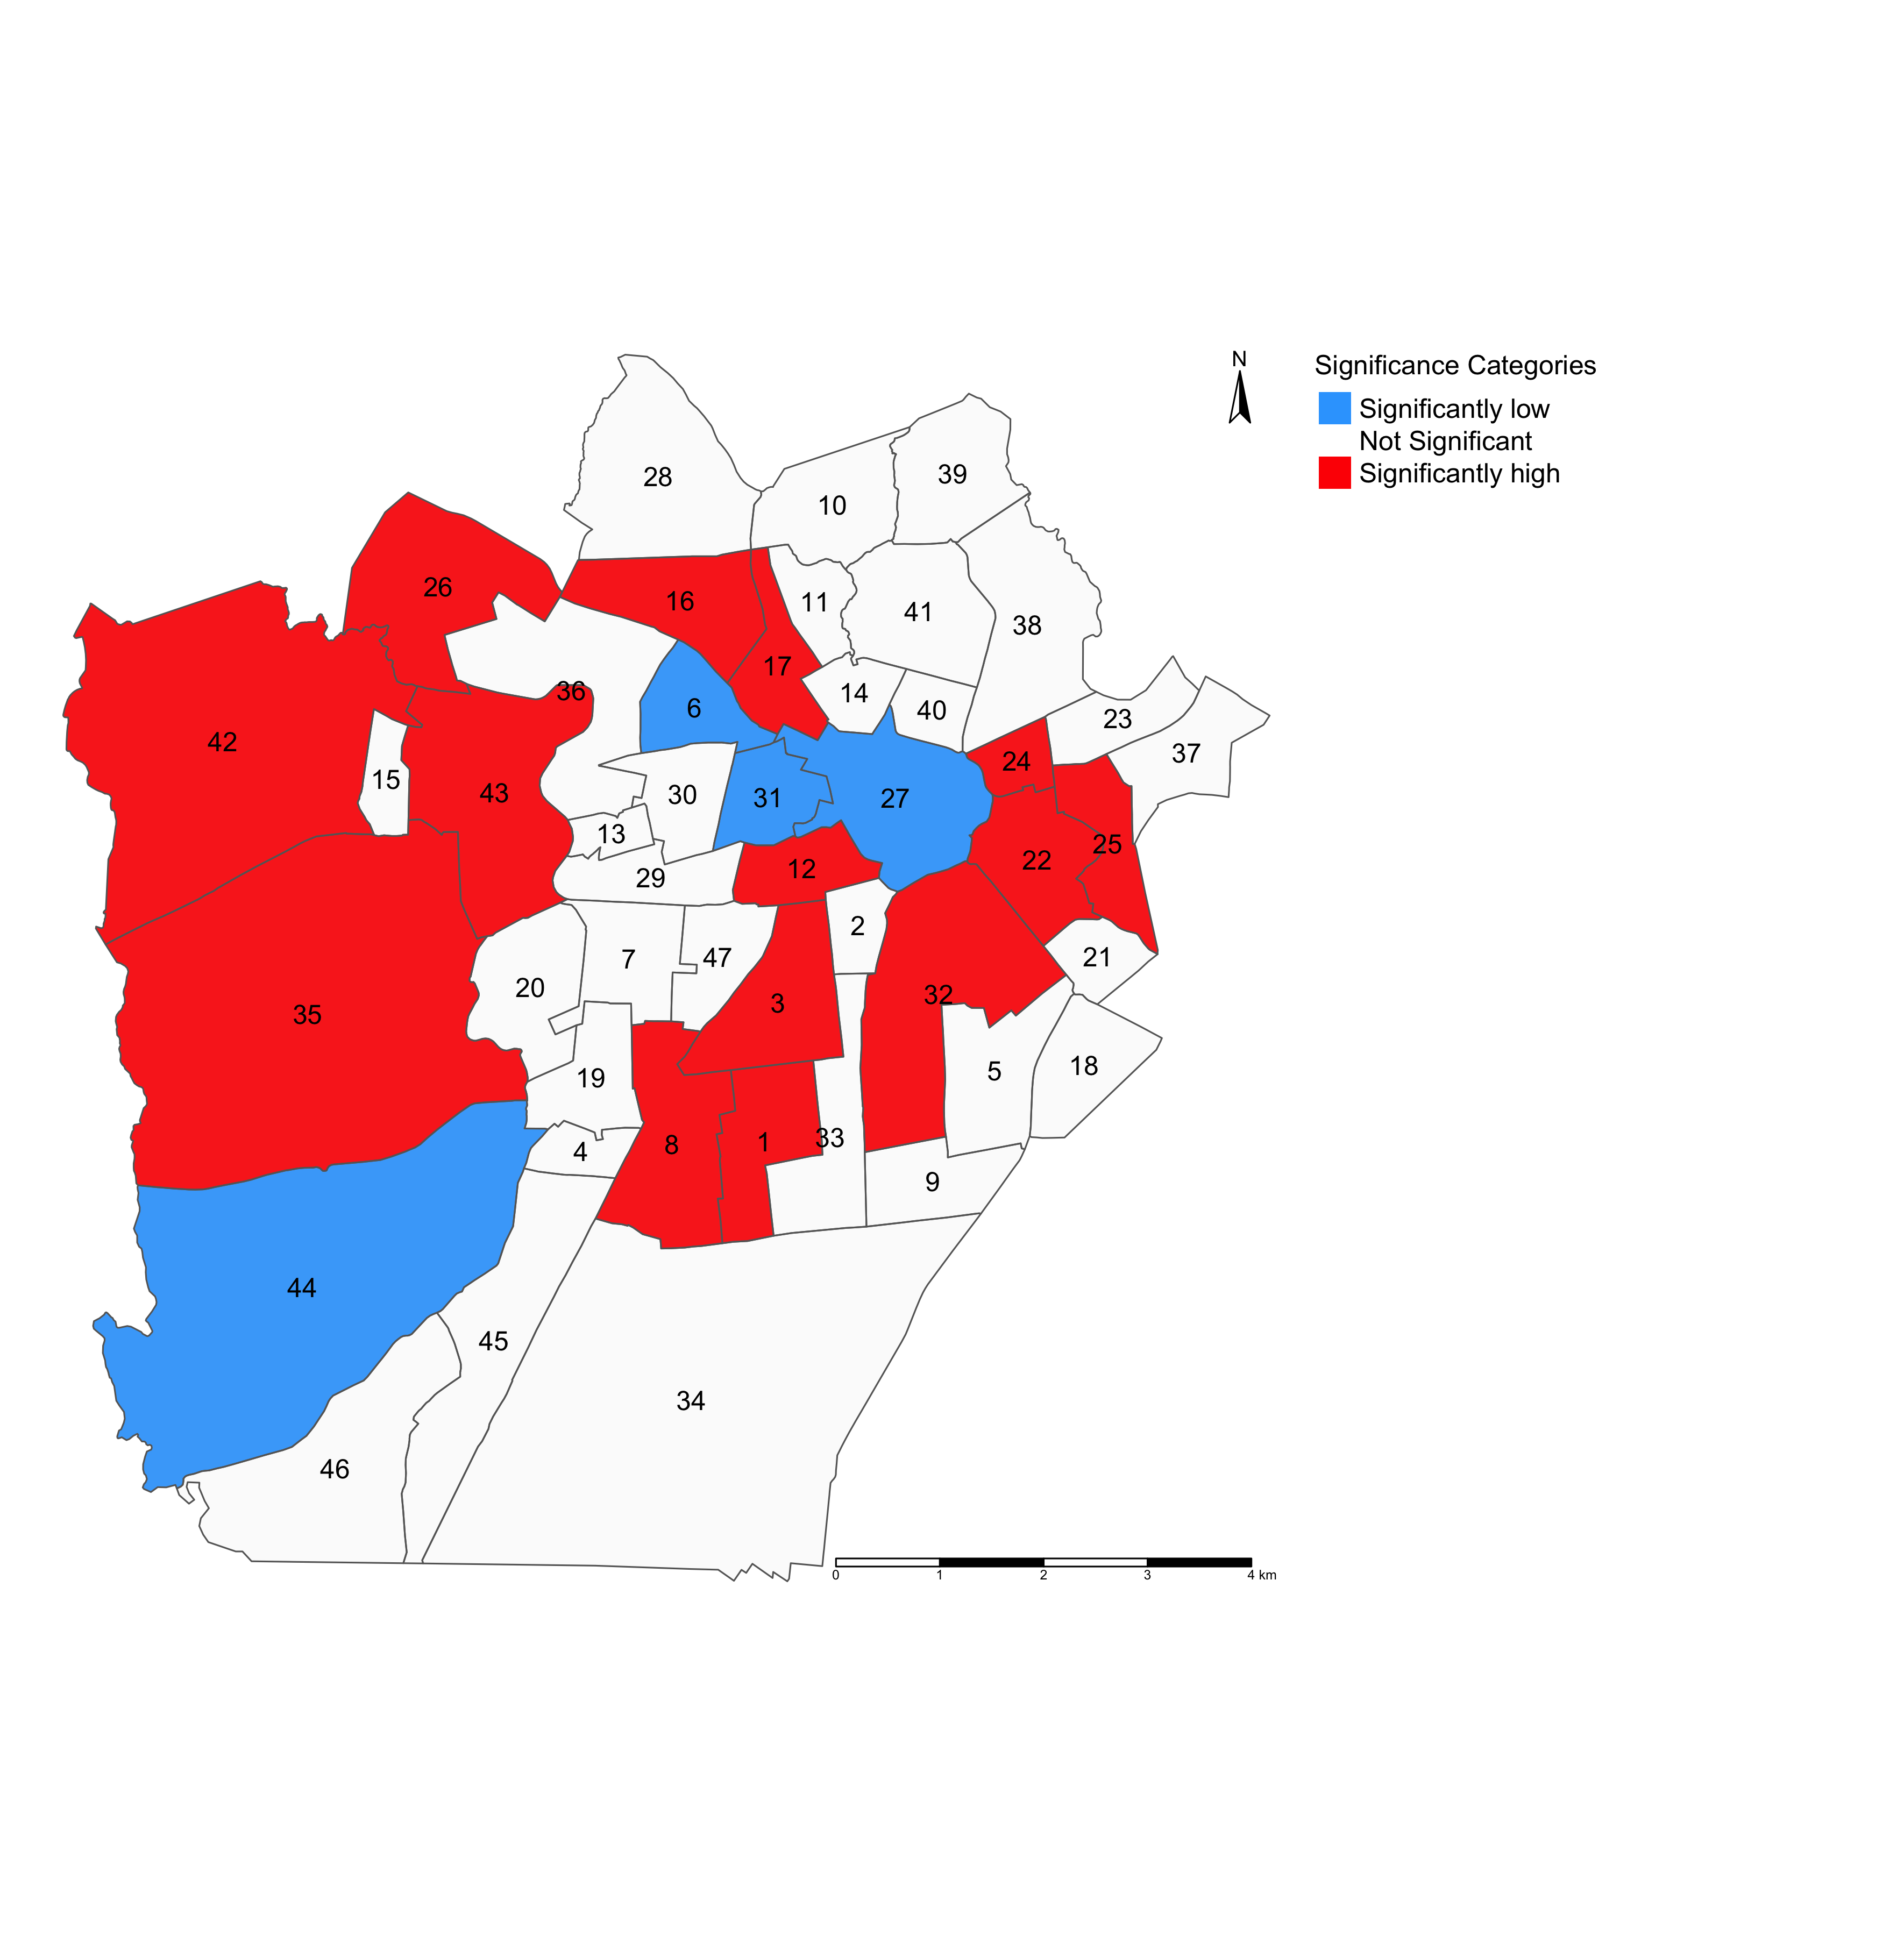
PART 1: Table results that illustrates the GLOBAL association between environmental, climate and anthropogenic factors and risk of infestation in Campina Grande (in LIRAa 2 survey period for April 2017) [Research framework is a cross-sectional study design].
Interpretation (examples):
Intercept: The overall risk of mosquito-borne infestation is 1.64 times (or 64%) higher in Campina Grande. The overall probability that there’s excess risk of infestation (i.e., RR > 1.00) is 51%.
Temperature: In relation to temperature, the risk of mosquito-borne infestation is 0.93 times (or 7%) lower in Campina Grande. The probability of observing an excess risk of infestation (i.e., RR > 1.00) in relation to temperature is 23%.
Urbanisation index: In relation to urbanisation, the risk of mosquito-borne infestation is 1.18 times (or 18%) higher in Campina Grande. The probability of observing an excess risk of infestation (i.e., RR > 1.00) in relation to urbanisation is 52%.
NOTE: All relative risk estimates have the null value (1) between its lower and upper 95% credibility intervals. While the results, excluding temperature, show an increased risk of infestation – these are all statistically not significant.
RR: Relative risks; Pr(RR > 1): Exceedance probabilities (the probability that RR being greater than 1)
PART 2: Maps on the left panel illustrates the relative risk (RR) of infestation across neighbourhoods in Campina Grande
PART 3: Maps on the right panel illustrates which neighbourhoods in Campina Grande have RRs that are significantly “low” or “high” risk
NOTE: There should be a map for
exceedance probabilities (this was not
shown)
LIRAa 2 2017
LIRAa 2 2017
Interpretation:
The following neighbourhoods in Campina Grande numbered 1, 3, 8 and 12 (for example) have RRs that are significantly above 1.00. These are examples of neighbourhoods containing households predicted to be at ‘high risk’ of being infested with mosquitoes. Neighbourhoods painted in RED need to be monitored for mosquito breeding hotspots to prevent further infestation, which, in turn, can lead to infectious disease outbreaks e.g., Zika or Dengue viruses!
RR < 1.00 (Low risk)
RR > 1.00 (High risk)
RR = 1.00 (Non-significant risk)
Continuous RR estimates
RR estimates categorised:
10

Slide 11
Scenarios
11

Slide 12
What if:
[1] The dataset are received in streams, or in a ‘repeated’ manner either on a regular or irregular interval
For example, the routine survey for mosquito infestation in Campina Grande, Brazil
 | Survey Periods
LIRAa | 2013 | 2014 | 2015 | 2016 | 2017
1 | January | January | January | April | January
2 | March | March | March | July | April
3 | May | May | May | October | July
4 | July | July | October
5 | October | October
Note: While the surveys are routine,
do you notice how the survey periods
are conducted irregular? The study
design is ecological study design
known to be in a repeated
cross-sectional framework.
When you have a scenario, like this, it would be improper to analysis it as ‘true’ longitudinal dataset or a spatial temporal fashion.
12

Slide 13
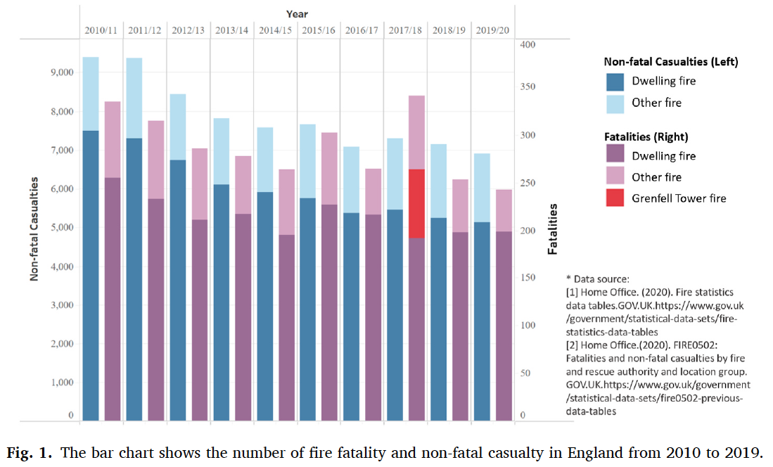
What if:
[2] The dataset are received in a full longitudinal format, where there is no lapses in the time frame i.e., the intervals
are ‘regular’
For example, annually report surveillance information on incident fire hazards across Fire Service Areas (FSA)
in England, UK
Note: The study design is also called an ecological study design known to be in a longitudinal framework.
When you have a scenario, like this, it would be proper to analyse it as ‘true’ longitudinal dataset
Li et al, (2022), Ecological study exploring the geospatial
associations between socioeconomic deprivation and
fire-related dwelling casualties in England (2010-2019),
DOI: https://doi.org/10.1016/j.apgeog.2022.102718
13

Slide 14
Scenarios
There are two approaches here:
[1]
[2]
Bayesian Model Updating
Spatial Temporal Models
14

Slide 15
Scenarios
[1]
[2]
Bayesian Model Updating
Spatial Temporal Models
The first scenario is the best approach for analysing data that’s received in streams on a ‘regular’ or ‘irregular’ basis. Suitable for use within a repeated cross-sectional analytical framework
15

Slide 16
Scenarios
[1]
[2]
Bayesian Model Updating
Spatial Temporal Models
The other scenario is the best approach for analysing data that’s received in longitudinal (which is often retrospective). It has no lapses in its interval. Suitable for use within a longitudinal analytical framework
16

Slide 17
Bayesian Updating
17

Slide 18
Bayesian Updating
Bayesian updating is a statistical method for revising the estimated probabilities about the events you’ve observed previously, and this revision is based on new evidence or information (data).
Bayesian updating technique is excellent choice for survey datasets that are generated routinely in a repeated cross-sectional fashion.
It is used for early warning modelling and off-the-fly predictions as soon as new data is received.
Bayesian updating needs to be executed in an iterative manner.
You have a baseline dataset, in which other subsequent data is applied to the Bayesian model for updating. Note that on the initial model with baseline information – you will need to specify the prior distribution for the parameters needed to be estimated. Afterwards, the model recalibrates itself by using the parameter estimates (i.e., posterior distribution) from the previous model run to set them as its new prior.
The updating will go through a process of a “learning curve” where you will see the estimated parameters evolve in the face of increasing data.
18
Notes:
Bayesian inference with a

Slide 19
Example: Risk assessment and mapping of infestation in Campina Grande using Bayesian updating
19

Slide 20
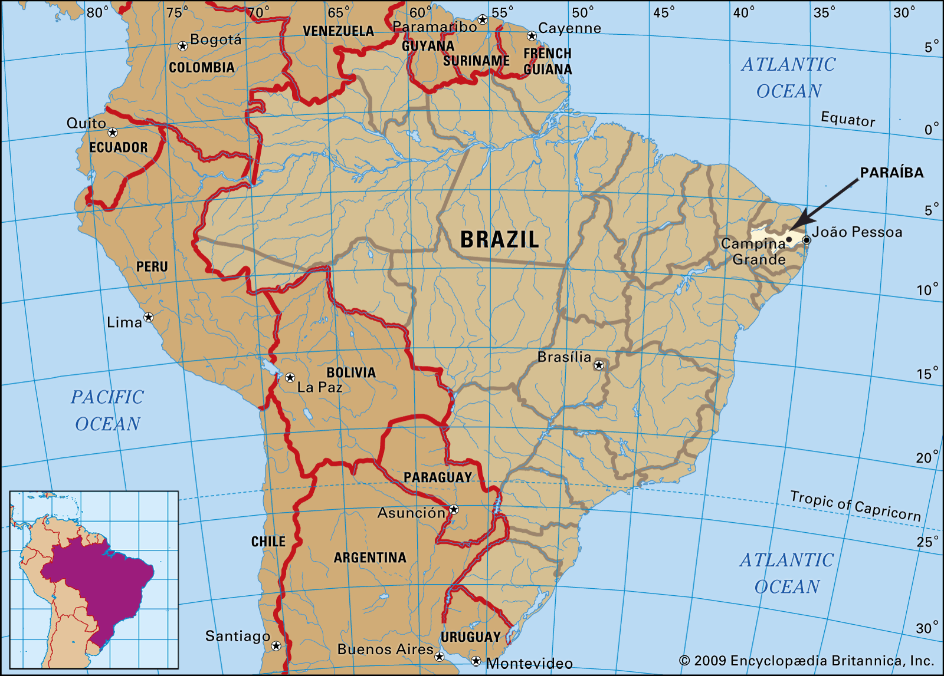
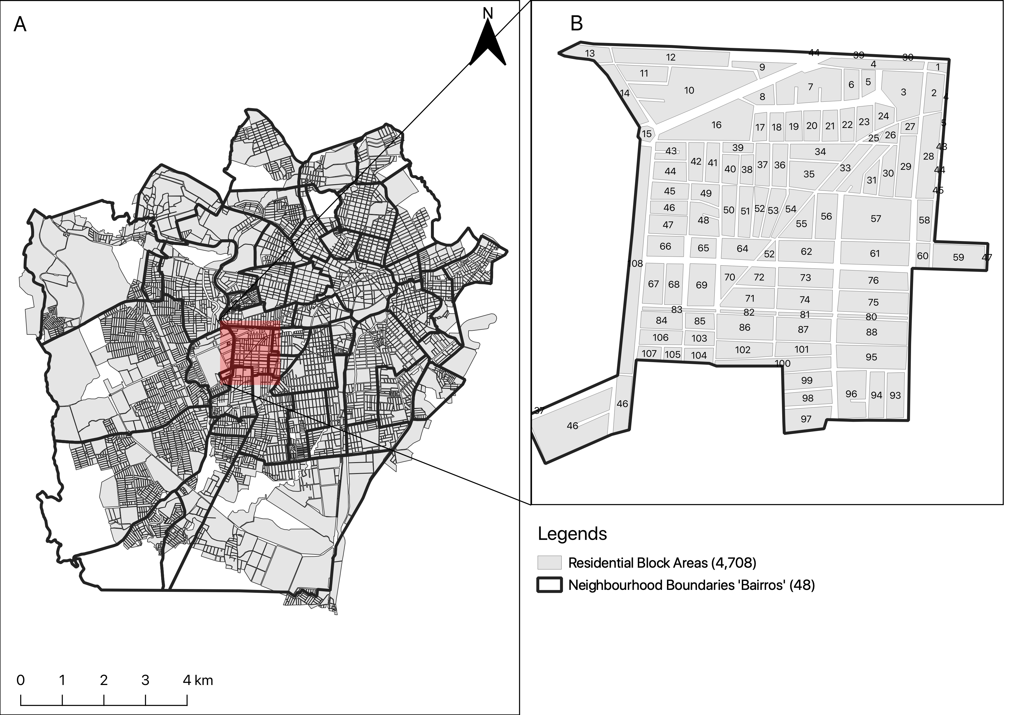
Campina Grande is into 47 neighbourhoods
Most recent vector control data (Levantamento Rapid de Indice para Aedes a [LIRAa]): January 2013 to October 2017 (performed 3–5 times in a year)
Baseline information – the overall number of houses in neighbourhood (as denominators); total number of households detected to be infested with larvae or adult mosquito (i.e., Aedes aegypti)
Aims and objectives:
To quantify the risk trajectories of mosquito infestation on a neighbourhood-level to informs the profile of the neighbourhood (i.e., whether the risks were sustained across the LIRAa periods).
Determining the set of environmental, climate and anthropogenic risk factors that impact neighbourhood-levels of Aedes aegypti infestation in households.
20
Notes:
Portuguese: Levantamento Rapido de Indice para Aedes aegypti (Rapid Index Survey for Aedes aegypti)

Slide 21
Research Methodology & Study design
 | Survey Periods
LIRAa | 2013 | 2014 | 2015 | 2016 | 2017
1 | January | January | January | April | January
2 | March | March | March | July | April
3 | May | May | May | October | July
4 | July | July | October
5 | October | October
Using these 6 snapshots demonstrate the application. This is a repeated cross-sectional framework
Methodology:
Population-based ecological study design within repeated cross-sectional (and retrospective) framework
For covariates, the analysis included:
WorldClim (4.5km) (Maximum temperature and Precipitation) (monthly)
MOD18A1.061 Terra Vegetation Indices 16-Day Global 500m to compute neighbourhood levels of vegetation based on the NDVI metrics (monthly)
Worldpop.org (100m) to extract rasters for urbanisation (which contains binary grids) to compute the fraction of surface that is urbanised for neighbourhoods (yearly).
Spatial risk model with Intrinsic Conditional Autoregressive (ICAR) Model; and applied Bayesian updating to derive new global coefficients for covariates for each LIRA survey, as well as neighbourhood-specific relative risk estimates.
21

Slide 22
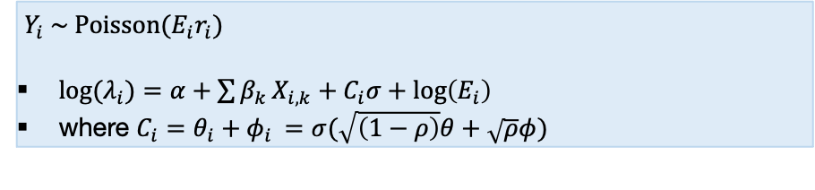
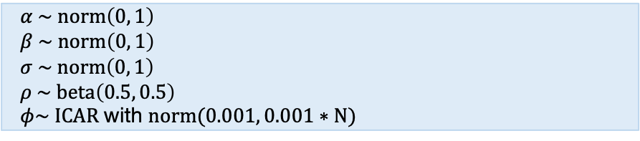
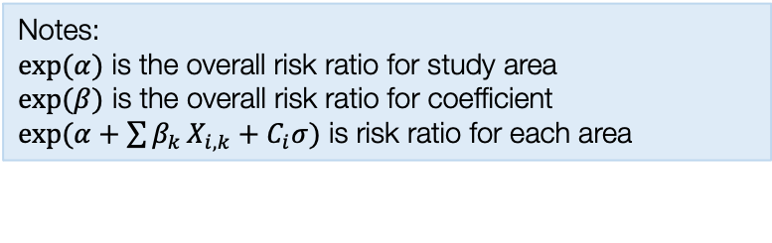
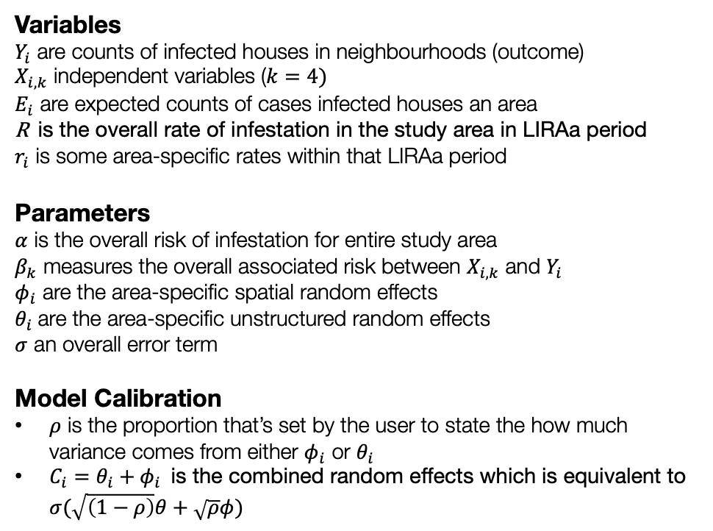
Model formulation for Spatial ICAR modelling and updating [1]
Model components
Full model specification
Variables
$Y_{i}$ are counts of infected houses in neighbourhoods (outcome)
$X_{i,k}$ independent variables ($k=4)$
$E_{i}$ are expected counts of cases infected houses an area
R is the overall rate of infestation in the study area in LIRAa period
$r_{i}$ is some area-specific rates within that LIRAa period
Parameters
$α$ is the overall risk of infestation for entire study area
$β_{k}$ measures the overall associated risk between $X_{i,k}$ and $Y_{i}$
$φ_{i}$ are the area-specific spatial random effects
$θ_{i}$ are the area-specific unstructured random effects
$σ$ an overall error term
Model Calibration
$ρ$ is the proportion that’s set by the user to state the how much variance comes from either $φ_{i}$ or $θ_{i}$
$C_{i}=θ_{i}+φ_{i}$ is the combined random effects which is equivalent to $σ(\sqrt{\left(1−ρ\right)}θ+\sqrt{ρ}φ)$
Specify likelihood function. The outcome is often counts – thus it will be Poisson (with log as the link function).
$Y_{i} \sim Poisson(E_{i}r_{i})$
${log⁡(λ}_{i})=α+\sum{β_{k}}X_{i,k}+C_{i}σ+log\left(E_{i}\right)$
where $C_{i}=θ_{i}+φ_{i}$ $=σ(\sqrt{\left(1−ρ\right)}θ+\sqrt{ρ}φ)$
Define the priors for the intercept, coefficients and spatial and unstructured random effects as with an ICAR specification
$α \sim norm\left(0, 1\right)$
$β \sim norm\left(0, 1\right)$
$σ \sim norm\left(0, 1\right)$
$ρ \sim beta\left(0.5, 0.5\right)$
$φ\sim ICAR$ with $norm(0.001, 0.001∗N)$
Build Bayesian model
Recall the Bayes’ Rule: $P\left(θ | Y\right)∝P\left(Y | θ\right)P(θ)$
$$P\left(α, β_{k}, σ, φ_{i} | { λ}_{i}\right)∝P\left({ λ}_{i} | α, β_{k}, σ, φ_{i}\right) P\left(α\right)P\left(β_{k}\right)P\left(σ\right)P(φ_{i})P\left(ρ\right)$$
Notes:
$exp⁡(α)$ is the overall risk ratio for study area
$exp⁡(β)$ is the overall risk ratio for coefficient
$exp(α+\sum{β_{k}}X_{i,k}+C_{i}σ)$ is risk ratio for each area
New models with LIRAa data that follows are updated, this is procedure is known as Bayesian updating.
22

Slide 23
Model formulation for Spatial ICAR modelling and updating [2]
[Step 1] Stan code
data {
int<lower=0> N;
int<lower=0> N_edges;
array[N_edges] int<lower=1, upper=N> node1;
array[N_edges] int<lower=1, upper=N> node2;
array[N] int<lower=0> Y;
vector<lower=1>[N] Offset;
int<lower=1> K;
matrix[N, K] X;
}
transformed data {
vector[N] log_Offset = log(Offset);
}
parameters {
real alpha; // intercept
vector[K] beta; // covariates
real<lower=0> sigma; // overall standard deviation
real<lower=0, upper=1> rho; // proportion unstructured vs. spatially structured variance
vector[N] theta; // unstructured random effects (heterogeneous)
vector[N] phi; // spatial random effects
}
transformed parameters {
vector[N] combined;
combined = sqrt(1 - rho) * theta + sqrt(rho) * phi;
}
model {
Y ~ poisson_log(log_Offset + alpha + X * beta + combined * sigma);
alpha ~ normal(0.0, 1.0); // prior for alpha: weakly informative
beta ~ normal(0.0, 1.0); // prior for betas: weakly informative
theta ~ normal(0.0, 1.0); // prior for theta: weakly informative
sigma ~ normal(0.0, 1.0); // prior for sigma: weakly informative
rho ~ beta(0.5, 0.5); // prior for rho: pulled for literature
target += -0.5 * dot_self(phi[node1] - phi[node2]);
sum(phi) ~ normal(0, 0.001 * N);
}
generated quantities {
vector[N] eta = alpha + X * beta + combined * sigma; // compute eta and exponentiate into mu
vector[N] rr_mu = exp(eta); // output the neighbourhood-specific relative risks in mu
vector[K] rr_beta = exp(beta); // output the risk ratios for each coefficient
real rr_alpha = exp(alpha); // output the risk ratios for the intercept
}
[Step 2] RStudio code
Note: We use this code to run the model for the first time on the initial dataset to get our baseline results
# Create that initial dataset
Lira2016_1 <- infestation_data[infestation_data$Year==2016 & infestation_data$LIRAa==1,]
y=Lira2016_1$InfestedNum
x=Lira2016_1[,c(11,12,13,15)]
e=Lira2016_1$Expected
stan.dataset.baseline <- list(N=n, N_edges=n_edges, node1=nod1, node2=nod2, Y=y, X=x, K=length(x), Offset=e)
Bayesian.model.baseline <- stan("Stan model file.stan", data=stan.dataset.baseline, iter=60000, chains=6, control = list(max_treedepth = 12), verbose = FALSE, seed = 72182605)
# extract the results for tables and map
23

Slide 24
Model formulation for Spatial ICAR modelling and updating [3]
[Step 3] RStudio code
# create the subsequent datasets for the updating
Lira2016_2 <- infestation_data[infestation_data$Year==2016 & infestation_data$LIRAa==2,]
Lira2016_3 <- infestation_data[infestation_data$Year==2016 & infestation_data$LIRAa==3,]
Lira2017_1 <- infestation_data[infestation_data$Year==2017 & infestation_data$LIRAa==1,]
Lira2017_2 <- infestation_data[infestation_data$Year==2017 & infestation_data$LIRAa==2,]
Lira2017_3 <- infestation_data[infestation_data$Year==2017 & infestation_data$LIRAa==3,]
# for Lira2016_2
y=Lira2016_2$InfestedNum
x=Lira2016_2[,c(11,12,13,15)]
e=Lira2016_2$Expected
stan.dataset.update1 <- list(N=n, N_edges=n_edges, node1=nod1, node2=nod2, Y=y, X=x, K=length(x), Offset=e)
# apply updating to next dataset based on posterior estimates from last model
Bayesian.model.update1 = stan(fit=Bayesian.model.baseline, data=stan.dataset.update1, iter=60000, chains=6, control = list(max_treedepth = 12), verbose = FALSE, seed = 72182605)
# extract the results for tables and map
### REPEAT
# for Lira2016_3
y=Lira2016_3$InfestedNum
x=Lira2016_3[,c(11,12,13,15)]
e=Lira2016_3$Expected
stan.dataset.update2 <- list(N=n, N_edges=n_edges, node1=nod1, node2=nod2, Y=y, X=x, K=length(x), Offset=e)
# again, apply updating to next dataset based on posterior estimates from last model
Bayesian.model.update2 = stan(fit=Bayesian.model.update1, data=stan.dataset.update2, iter=60000, chains=6, control = list(max_treedepth = 12), verbose = FALSE, seed = 72182605)
# extract the results for tables and map
### RINSE AND REPEAT UNTIL ALL DATASETS ARE COMPLETED
24

Slide 25
Table results illustrates the overall association between environmental, climate and anthropogenic factors and risk of infestation in Campina Grande.
Baseline
Updated from 2016’s LIRAa 1
Updated from 2016’s LIRAa 1 & 2
Updated from 2016’s LIRAa 1, 2 & 3
Updated from 2016’s LIRAa 1, 2 & 3, and 2017’s LIRAa 1
Updated from 2016’s LIRAa 1, 2 & 3, and 2017’s LIRAa 1 and 2
RR: Relative risks
Pr(RR > 1): Exceedance probabilities (the probability that RR being greater than 1)
25

Slide 26
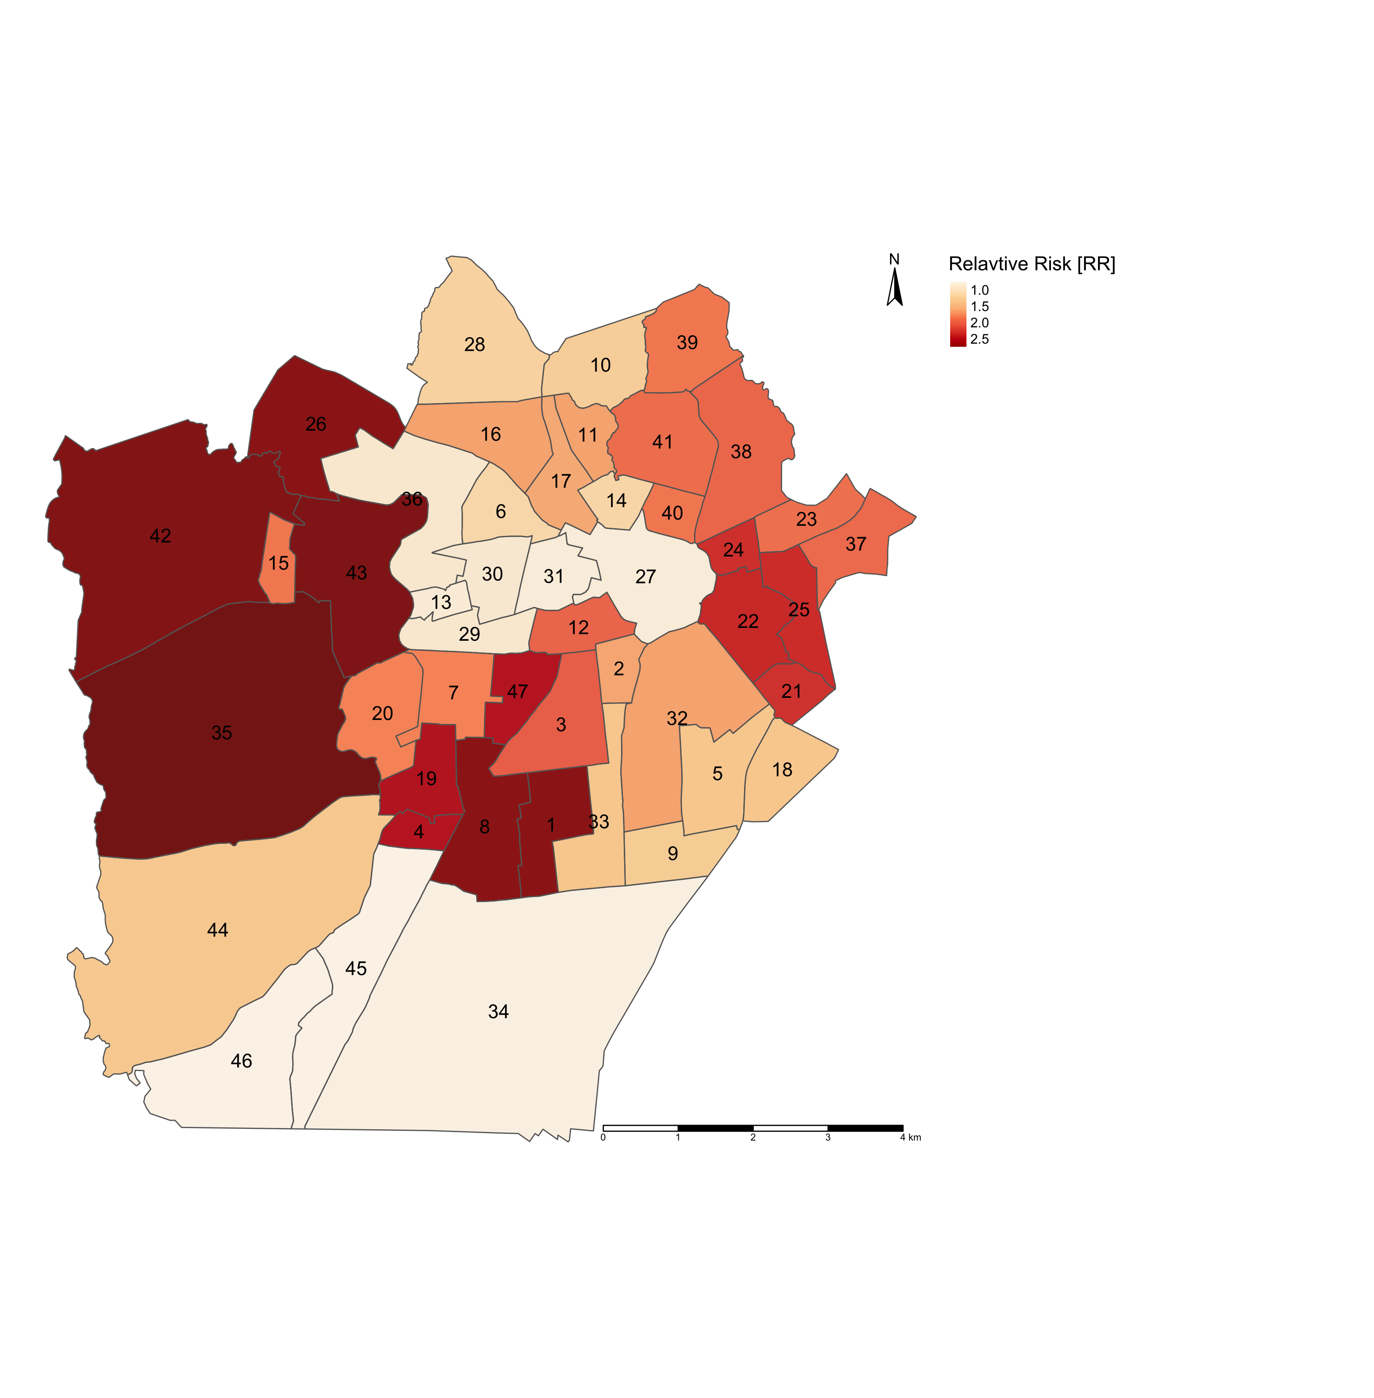
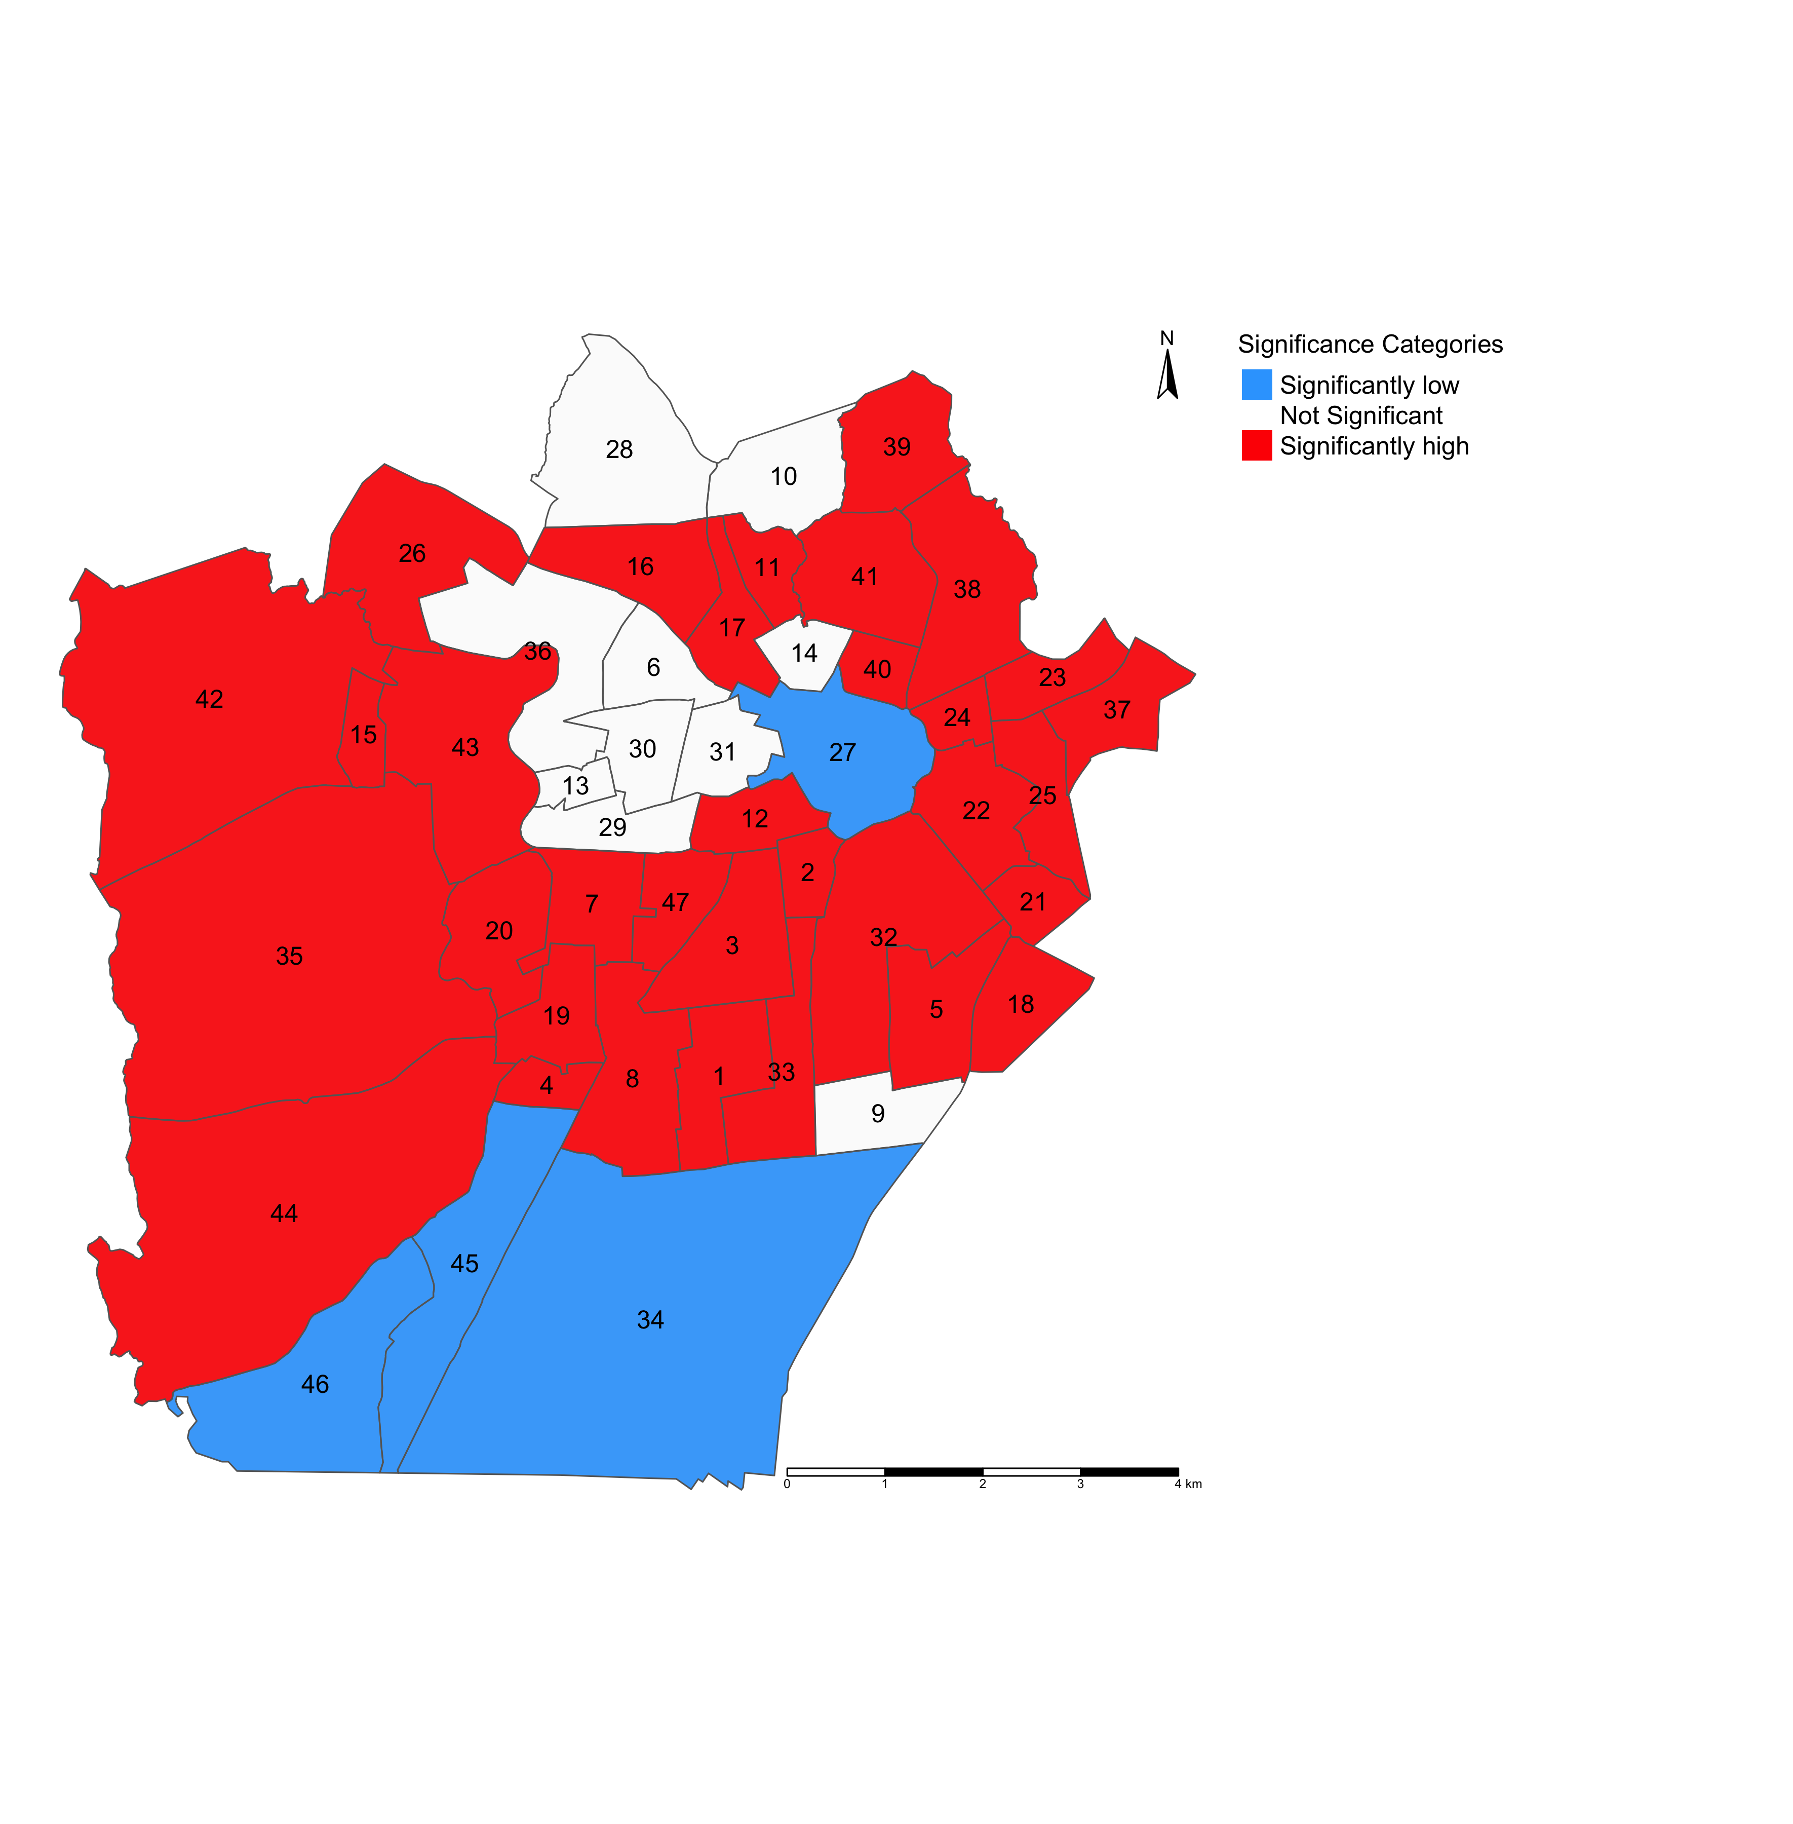
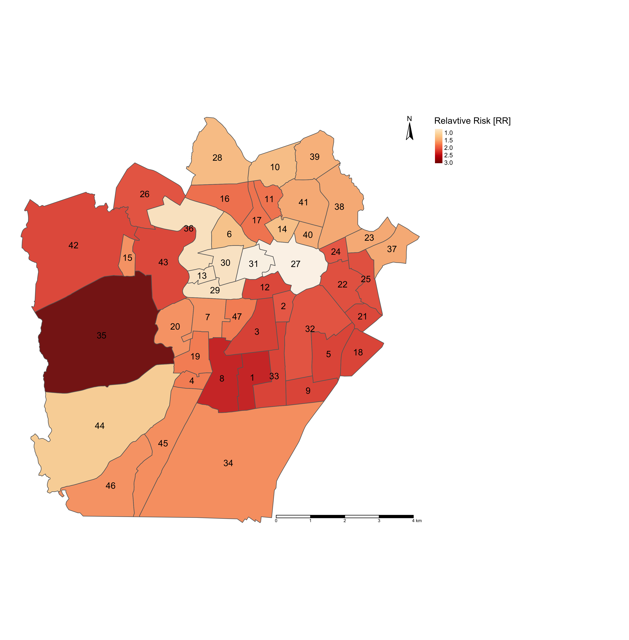
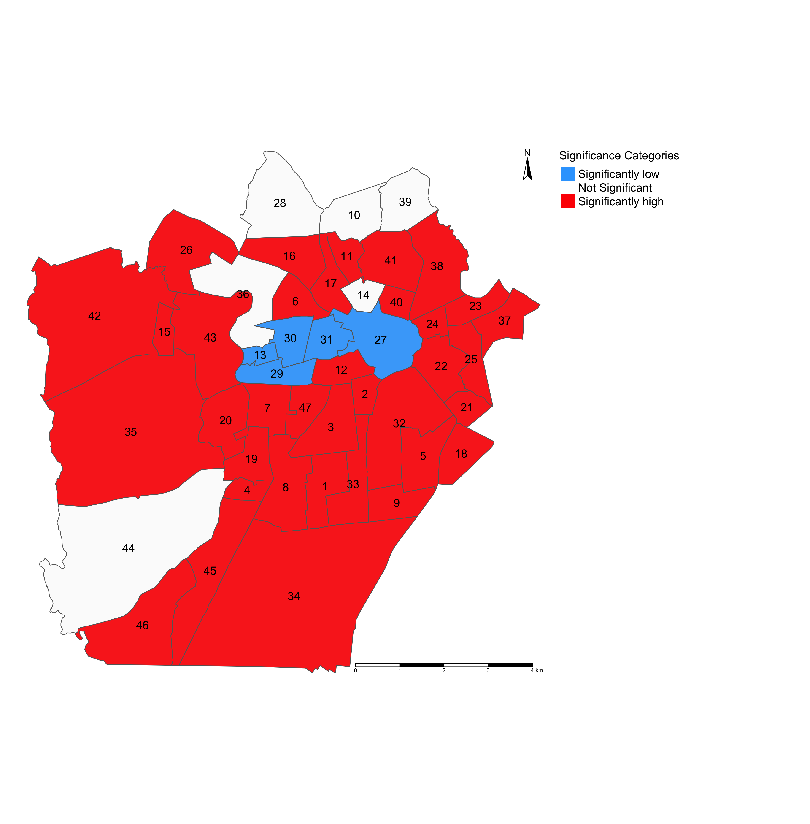
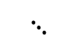
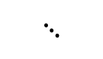



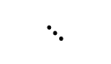
Maps on the left panel illustrates the relative risk (RR) of infestation across neighbourhoods in Campina Grande
Maps on the right panel illustrates which neighbourhoods in Campina Grande have RRs that are significantly “low” or “high” risk
$$⋱$$
$$⋱$$
$$⋱$$
$$⋱$$
LIRAa 1 2017
LIRAa 1 2017
LIRAa 2 2017
LIRAa 2 2017
LIRAa 3 2017
LIRAa 3 2017
$$⋱$$
$$⋱$$
RR < 1.00 (Low risk)
RR > 1.00 (High risk)
RR = 1.00 (Non-significant risk)
26

Slide 27
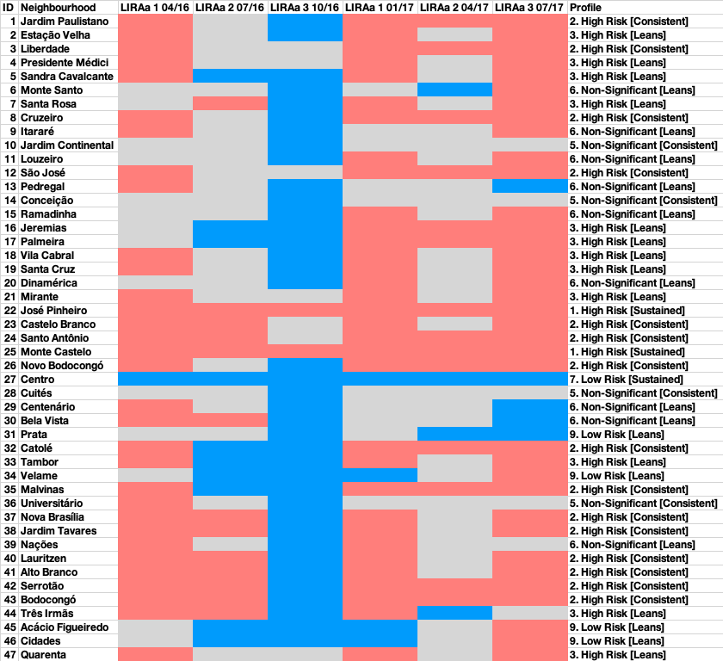
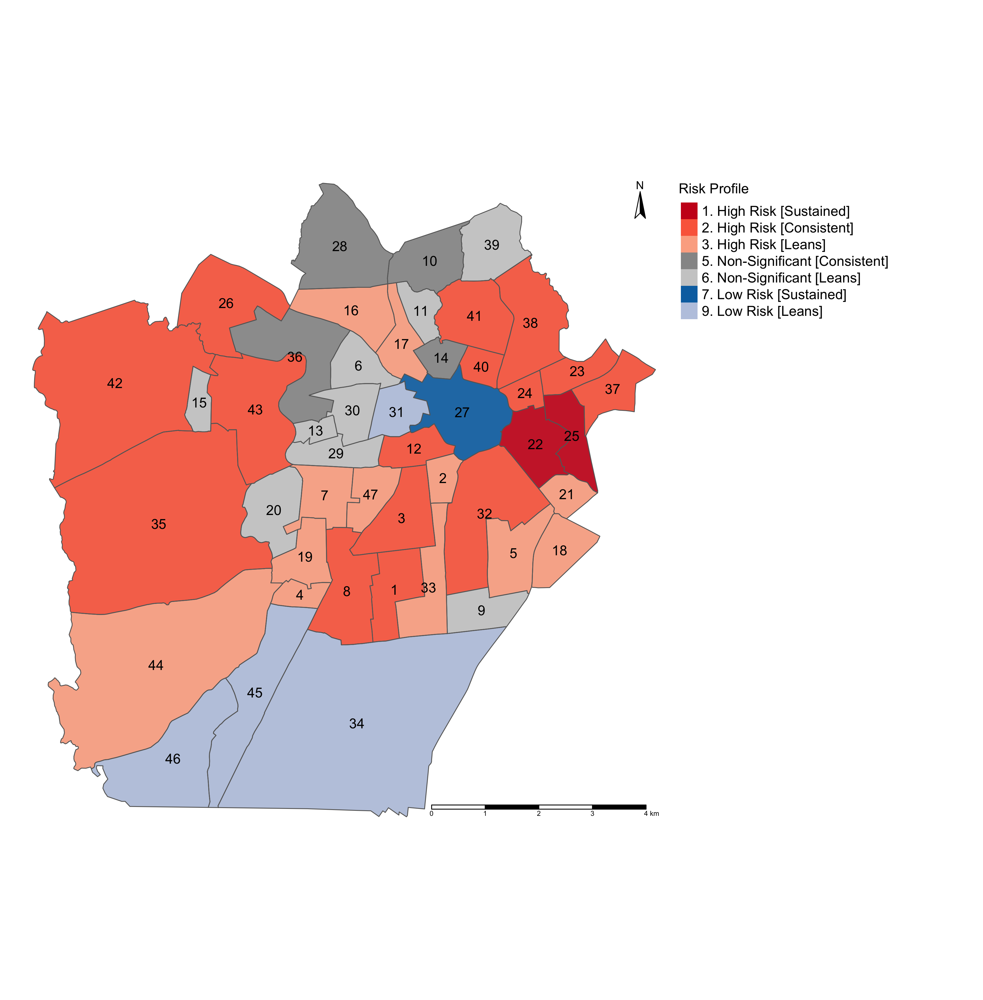
Modelling the risk trajectories and charting them across these LIRAa periods
Profiling the neighbourhoods accordingly to examine where these significant risks of infestation are sustained
I will show you how to pull this off in the practicals!
27

Slide 28
Spatial Temporal Models
28

Slide 29
Software for Bayesian methods beyond Stan
INLA (Integrated Nested Laplace Approximation)
INLA allows to a perform approximate Bayesian inference in latent Gaussian models, ranging from a tonne of generalized linear (mixed) models to various spatial models (e.g., Besag-York-Mollie & SPDEs)
Thanks to R-INLA Project (http://www.r-inla.org) – it has made learning Bayesian modelling very easy and accessible to anyone with basic knowledge of statistics
The codes are streamed-lined and infinitely easier to code than in Stan
It’s a lot efficient when it comes to speed
29

Slide 30
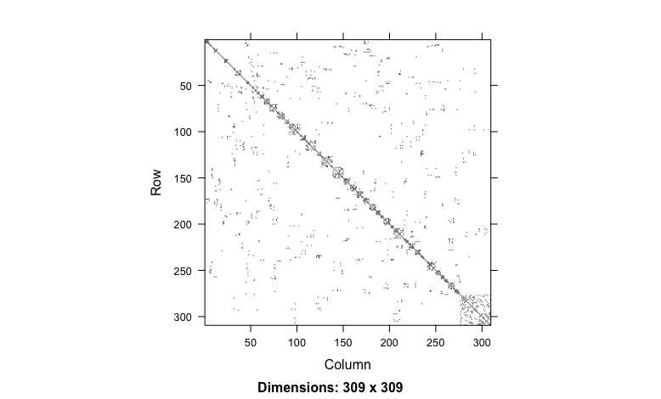
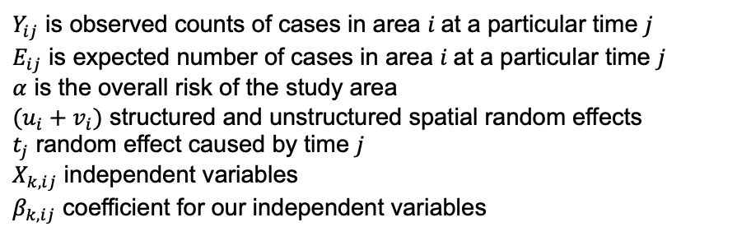
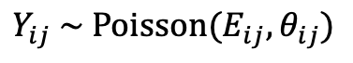
309 areal units (i) followed over (j) times
Adjacency matrix for Local Authority area u_{i}
We will use this to construct our spatial random effects unlike Stan, INLA uses an adjacency matrix
Model formulation
Model components
$$Y_{ij} \sim Poisson(E_{ij},θ_{ij})$$
$Y_{ij}$ is observed counts of cases in area $i$at a particular time $j$
$E_{ij}$ is expected number of cases in area $i$at a particular time $j$
$α$ is the overall risk of the study area
$(u_{i}+v_{i})$ structured and unstructured spatial random effects
$t_{j}$ random effect caused by time $j$
$X_{k,ij}$ independent variables
$β_{k,ij}$ coefficient for our independent variables
$${log⁡(θ}_{ij})=α+u_{i}+ v_{i}+\left(X_{k,ij}β_{k,ij}\right)t_{j}+\log\left(E_{ij}\right)$$
<<<
30

Slide 31
309 areal units (i) followed over (j) times
Adjacency matrix for Local Authority area u_{i}
We will use this to construct our spatial random effects unlike Stan, INLA uses an adjacency matrix
Model formulation
The code is quite simple
$$Y_{ij} \sim Poisson(E_{ij},θ_{ij})$$
$${log⁡(θ}_{ij})=α+u_{i}+ v_{i}+\left(X_{k,ij}β_{k,ij}\right)t_{j}+\log\left(E_{ij}\right)$$
We can get our relative risks, significance, and exceedance probabilities for this code
formula = Y ~ 1 + f(AreaID, model = "bym2", graph = g, hyper = prior) +
f(AreaID1, timeID, model = "bym2") + timeID
31

Slide 32
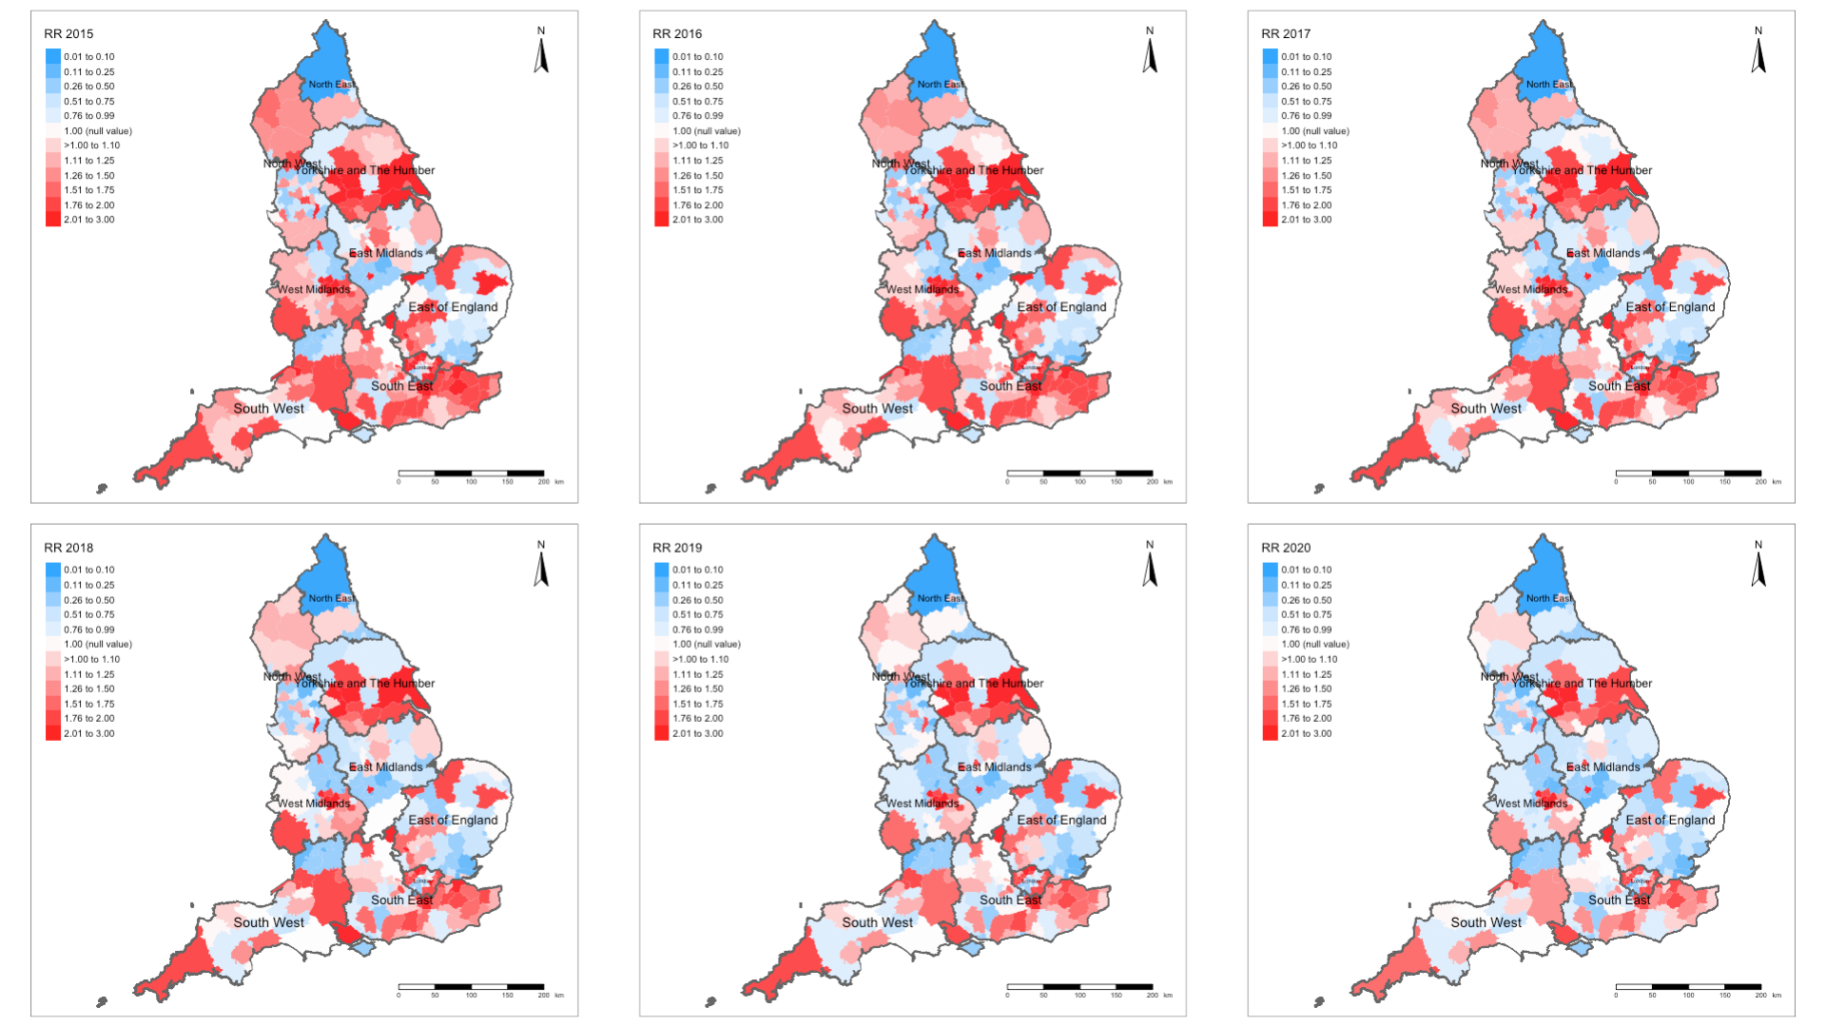
Example: Spatiotemporal Risks of Road-related casualties in England 2015-2020 [1]
Spatially and temporally varying relative risk estimates
32

Slide 33
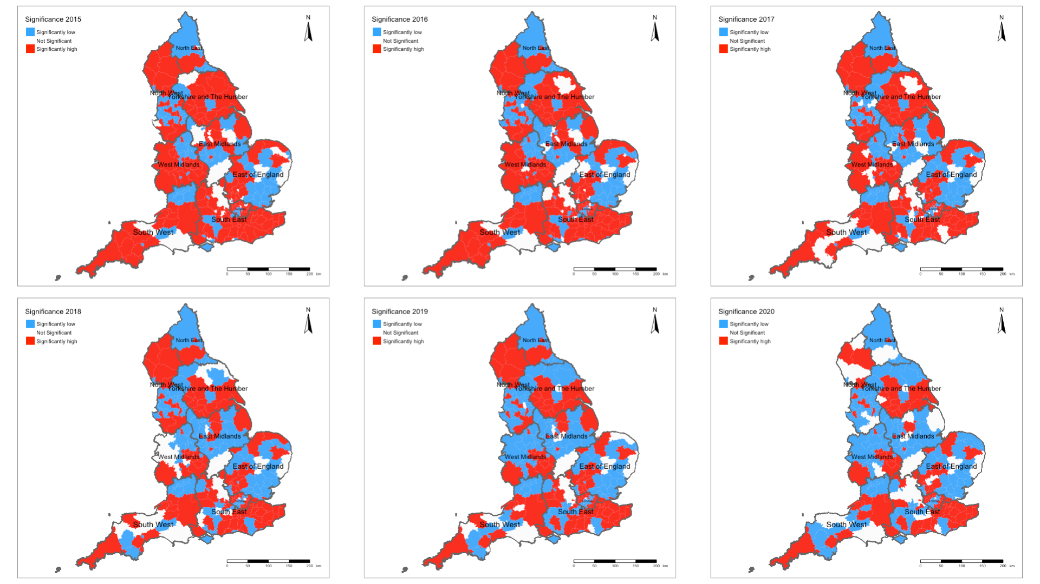
Example: Spatiotemporal Risks of Road-related casualties in England 2015-2020 [2]
Spatially and temporally varying significance categories
33

Slide 34
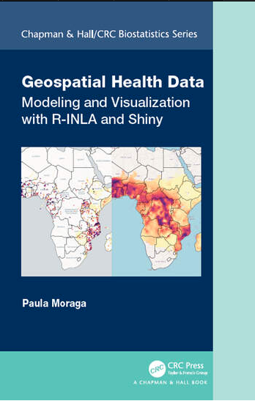
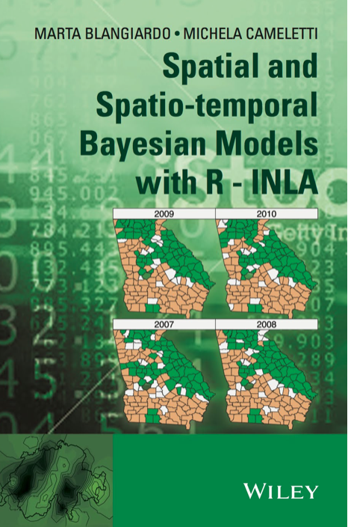
34

Slide 35
Example: Fire-related casualties in England (2010-19) with spatial temporal risk modelling
35

Slide 36
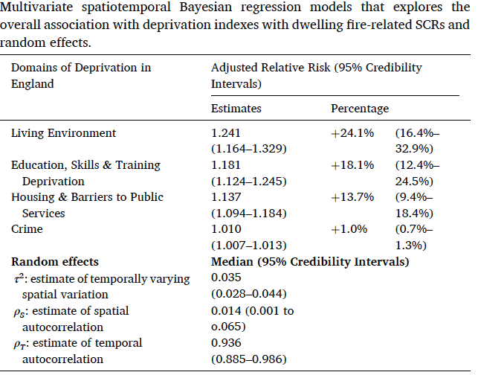
Table results illustrates the overall association between socioeconomic deprivation factors and risk of fire-related casualties in England (2010-19).
Interpretation:
Living environment: In the context of this socioeconomic deprivation domain – increased levels significantly increases the risk of fire-related casualties by 24.1% (1.241 times higher).
Barriers to housing and public service: In the context of this socioeconomic deprivation domain – increased levels significantly increases the risk of fire-related casualties by 13.7% (1.137 times higher).
Education, Skills & Training: In the context of this socioeconomic deprivation domain – increased levels significantly increases the risk of fire-related casualties by 18.1% (1.181 times higher).
Crime: In the context of this socioeconomic deprivation domain – increased levels marginally increases the risk of fire-related casualties by 1.0% (1.01 times higher). While this is statistically significant, the significance can be seen as something that is marginal.
NOTE: The random effects are reported in this instance to show the variation in risk. Most of it is captured in the time component (0.936 = 93.6%) meaning that there is a very strong temporal autocorrelation in the data.
Source: Li et al, (2022), Ecological study exploring the geospatial
associations between socioeconomic deprivation and
fire-related dwelling casualties in England (2010-2019),
DOI: https://doi.org/10.1016/j.apgeog.2022.102718
36

Slide 37
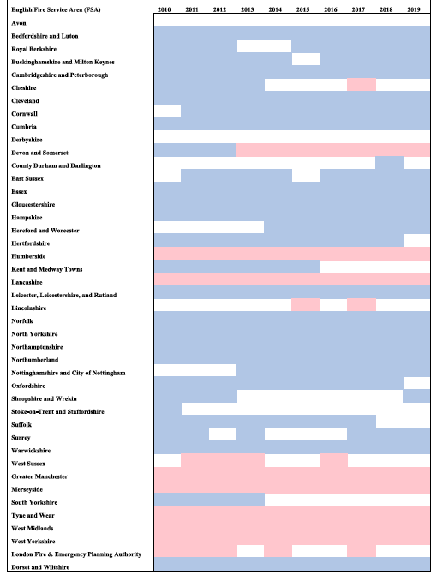
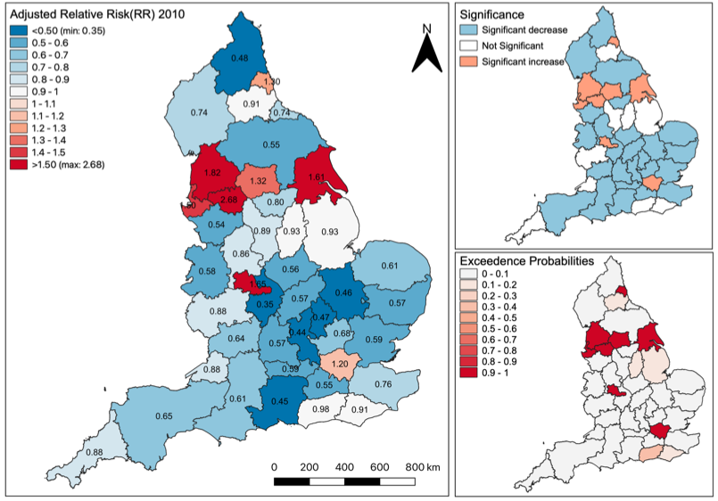
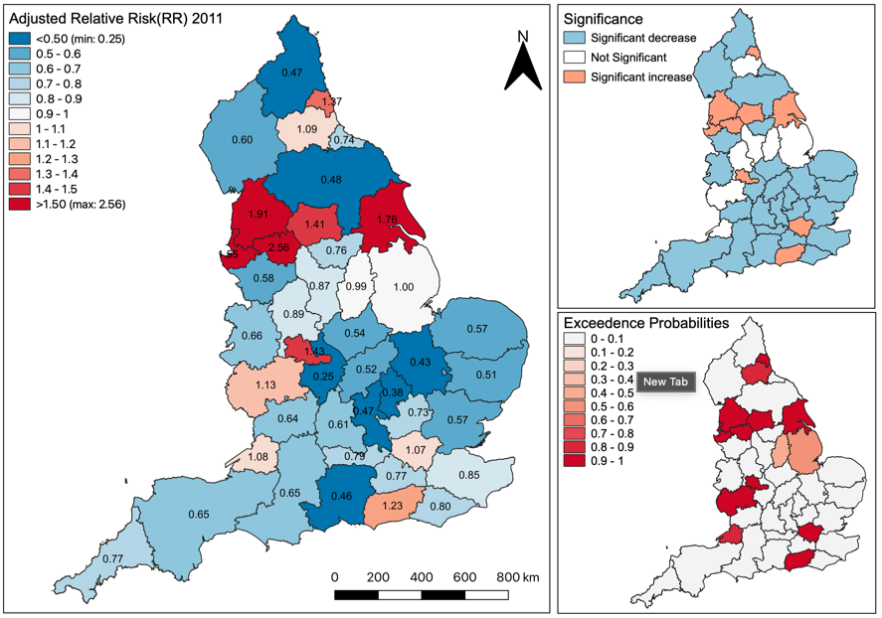
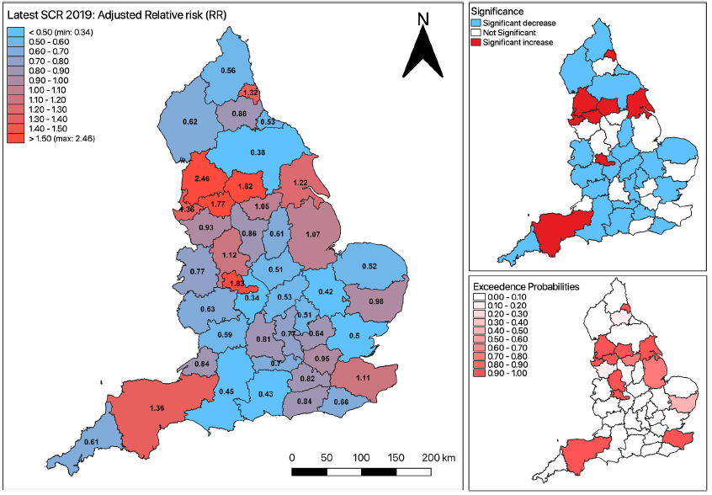



Spatial and temporal variation in risk of fire-related casualties
Translate maps to show significant risk trajectories
$$⋱$$
$$⋱$$
>>>
$$⋱$$
Interpretation: On a year-on-year basis, the increased risks are significantly sustained throughout the 10-year period for Humberside, Lancaster, Greater Manchester, Merseyside, Tyne and Wear, West Midlands, West Yorkshire, and Devon & Somerset.
Source: Li et al, (2022), Ecological study exploring the geospatial associations between socioeconomic deprivation and fire-related dwelling casualties in England (2010-2019). DOI: https://doi.org/10.1016/j.apgeog.2022.102718
37

Slide 38
Any questions?
38

